Slide 1
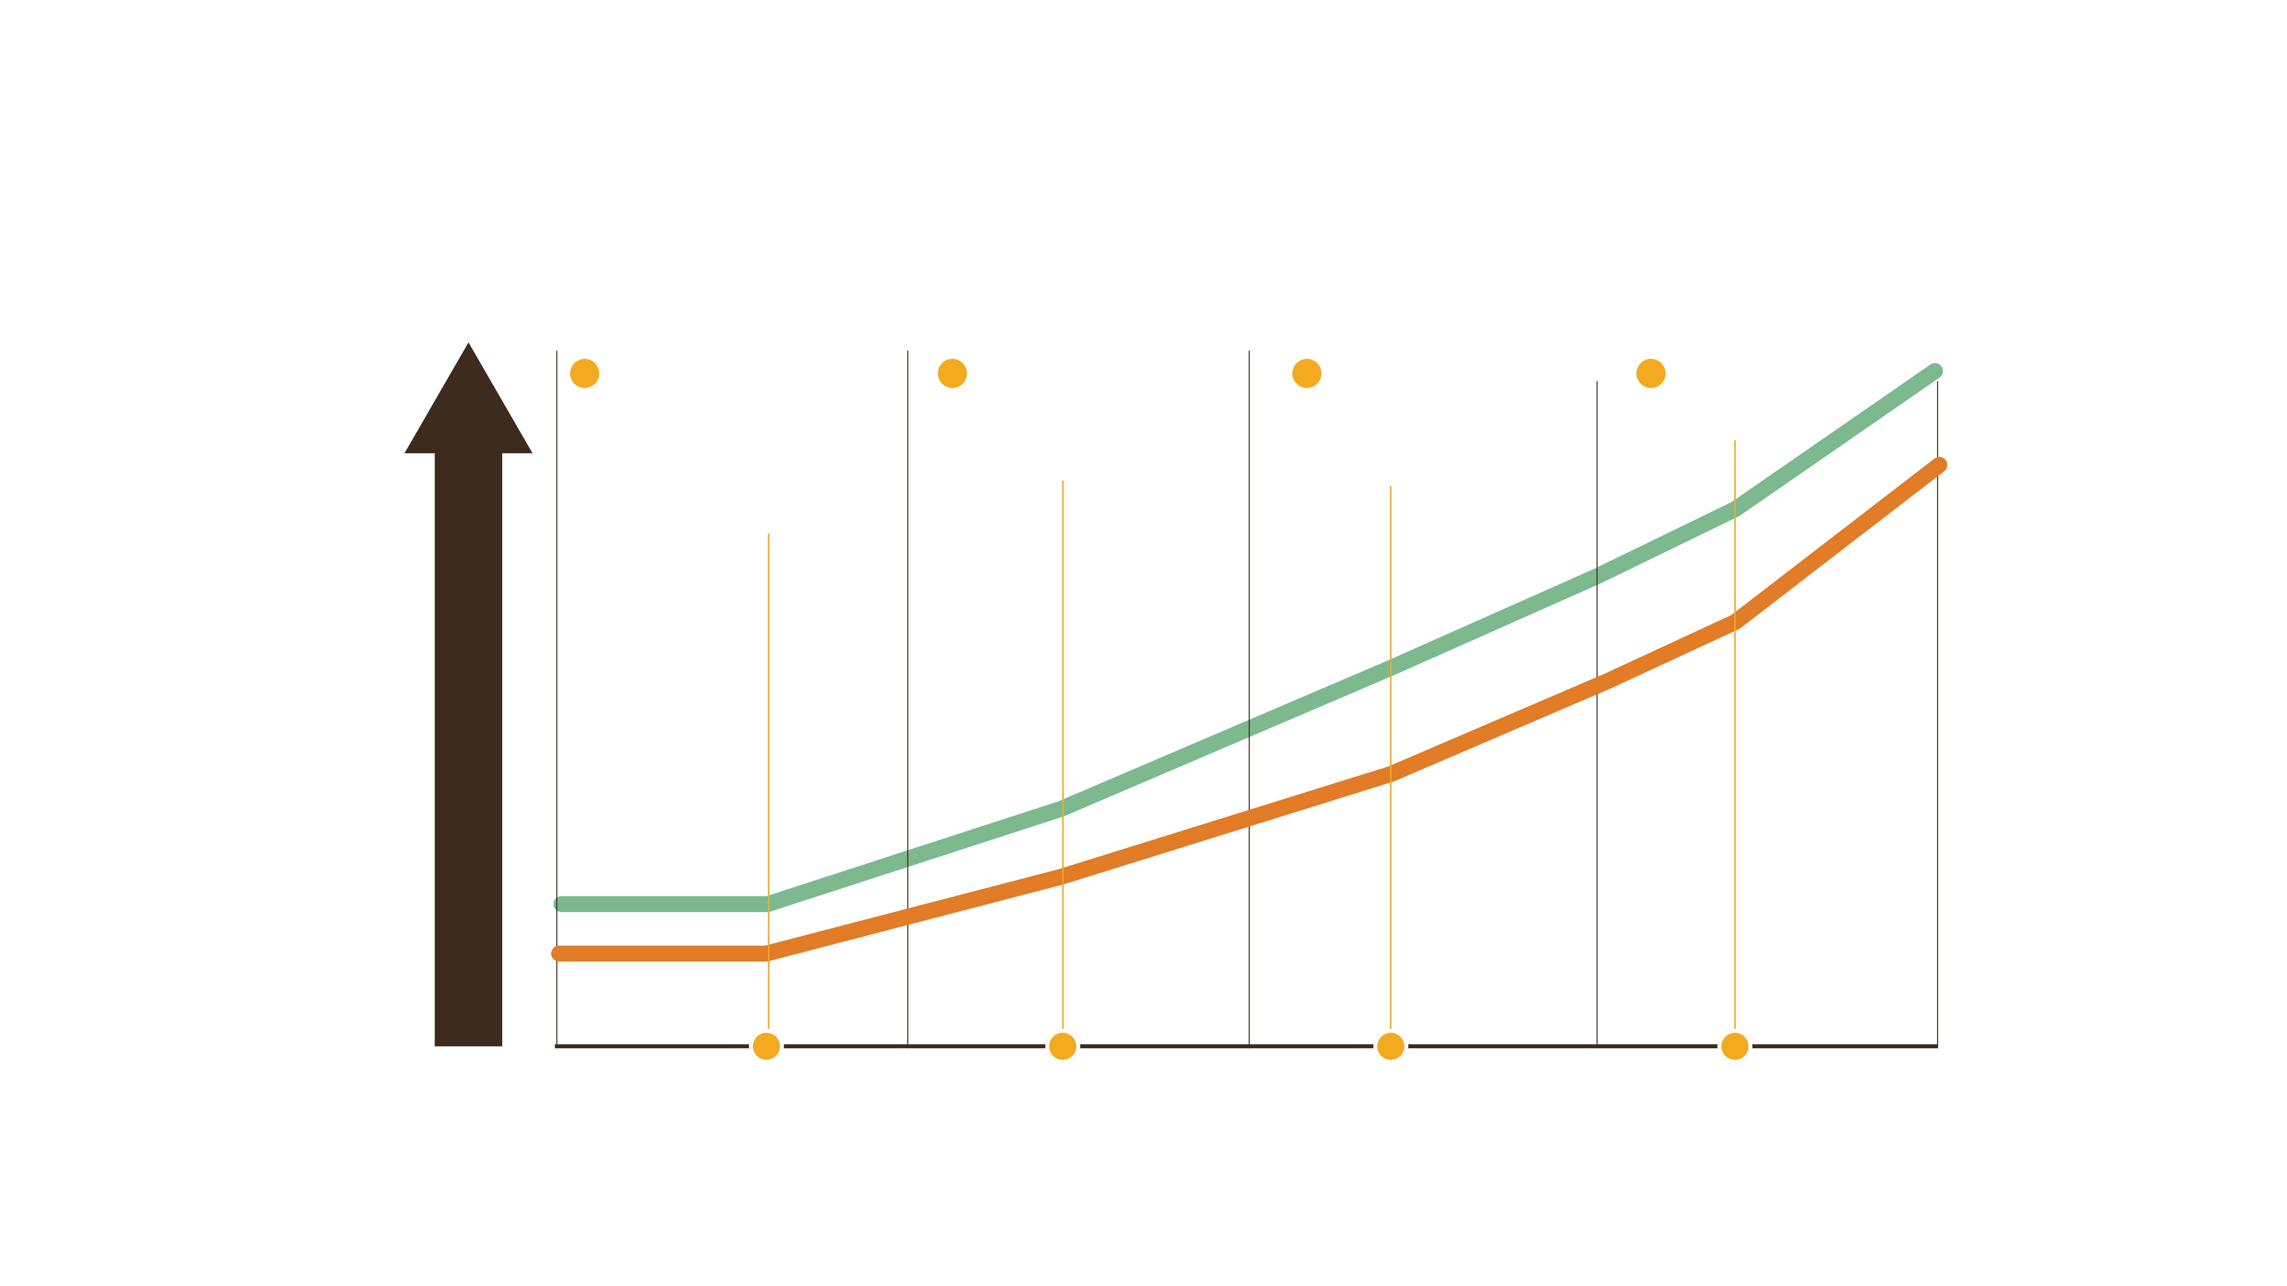
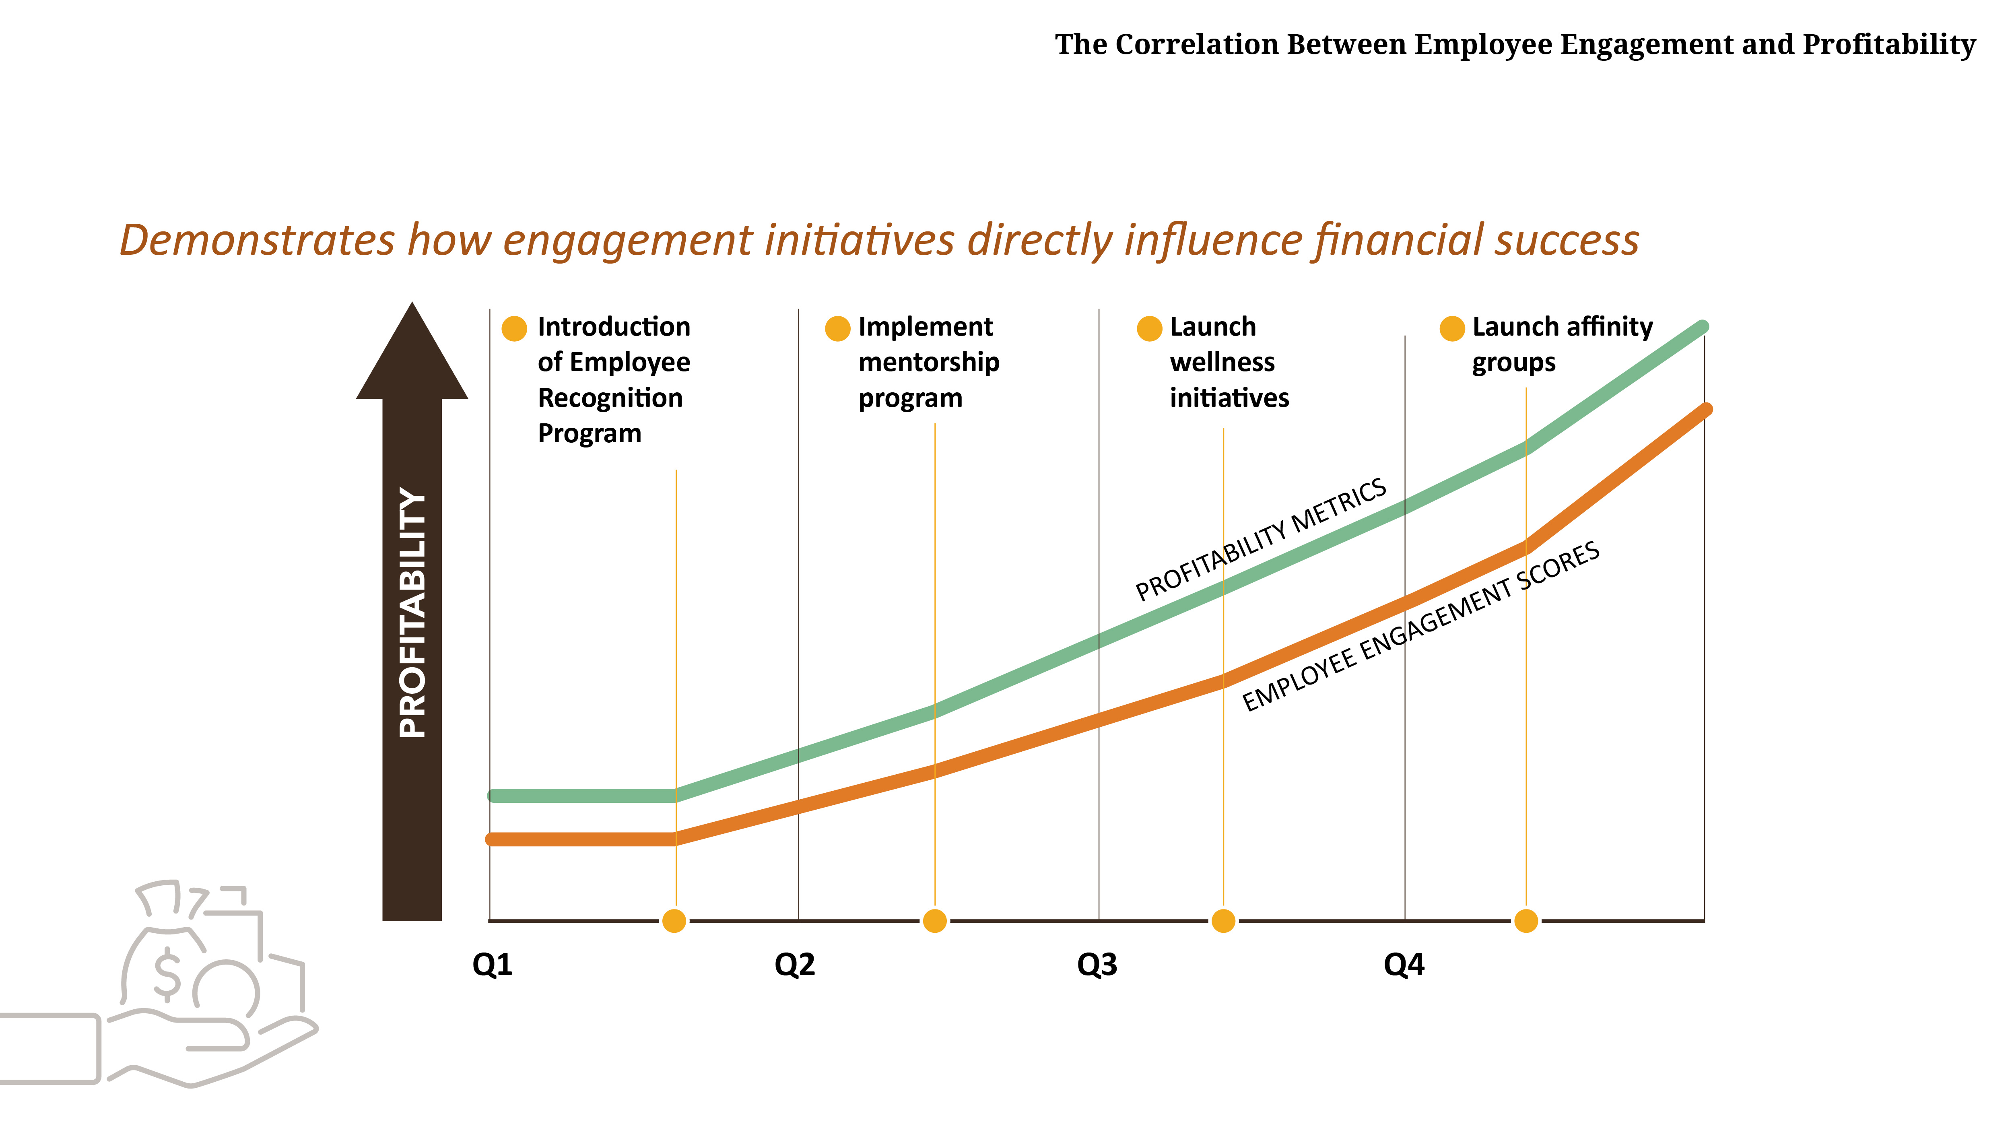

The Correlation Between Employee Engagement and Profitability
Demonstrates how engagement initiatives directly influence financial success
Introduction of Employee Recognition Program
Implement mentorship program
Launch wellness initiatives
Launch affinity groups
PROFITABILITY METRICS
PROFITABILITY
EMPLOYEE ENGAGEMENT SCORES
Q1
Q2
Q3
Q4

Slide 2
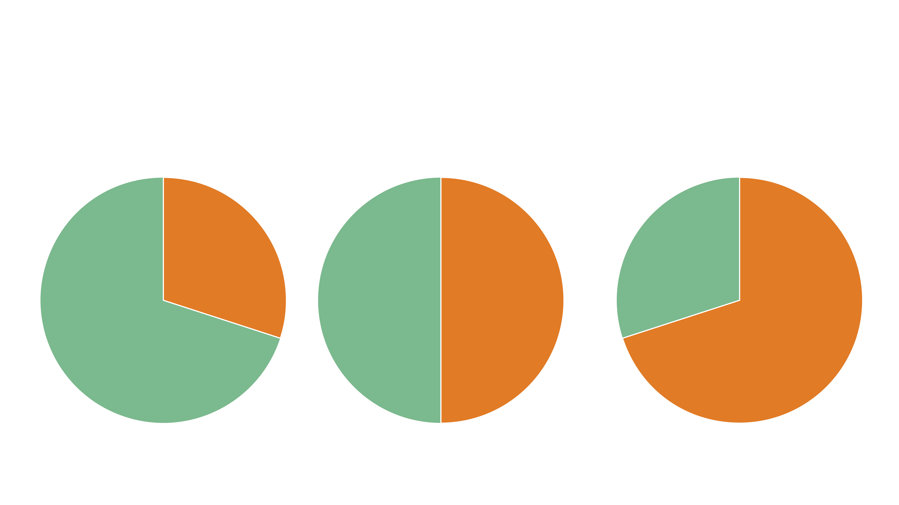
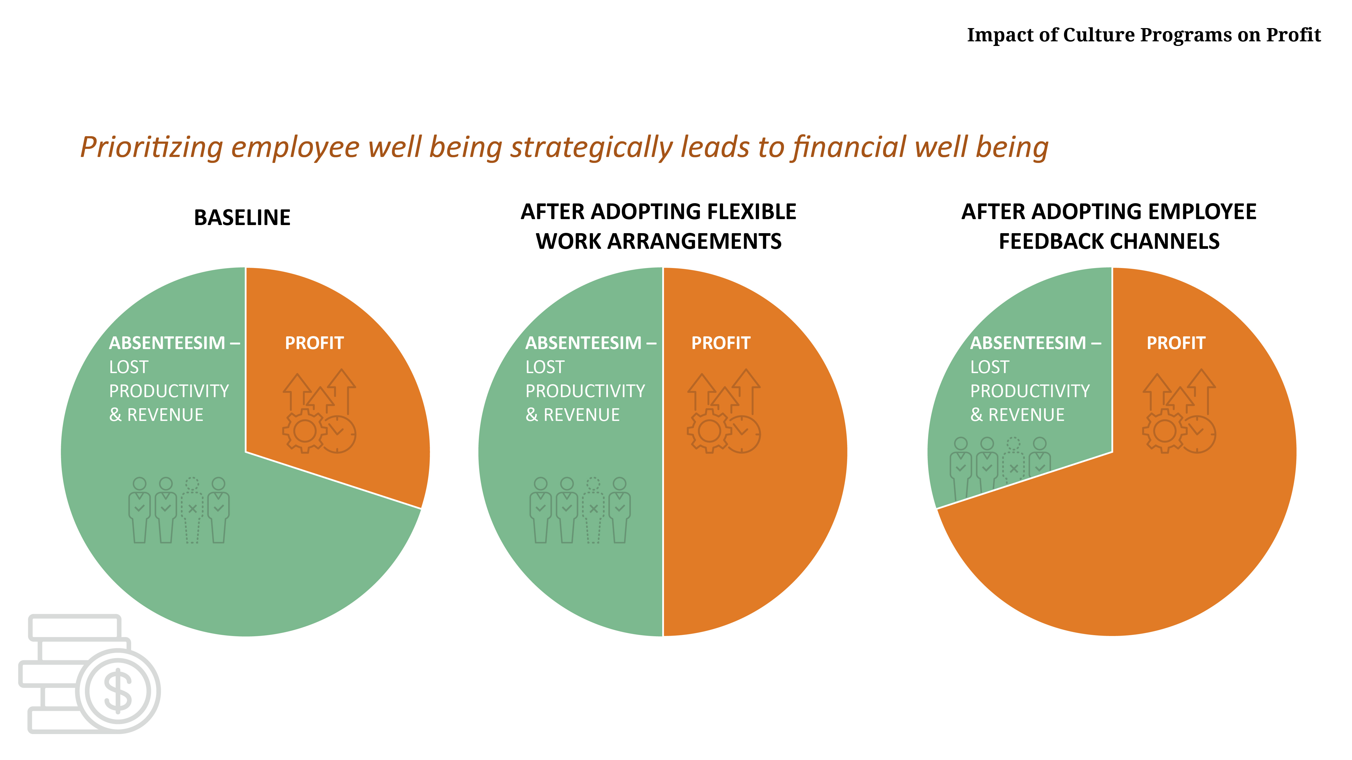




Impact of Culture Programs on Profit
Prioritizing employee well being strategically leads to financial well being
BASELINE
AFTER ADOPTING FLEXIBLE WORK ARRANGEMENTS
AFTER ADOPTING EMPLOYEE FEEDBACK CHANNELS
ABSENTEESIM LOST PRODUCTIVITY & REVENUE
PROFIT
ABSENTEESIM LOST PRODUCTIVITY & REVENUE
PROFIT
ABSENTEESIM LOST PRODUCTIVITY & REVENUE
PROFIT

Slide 3
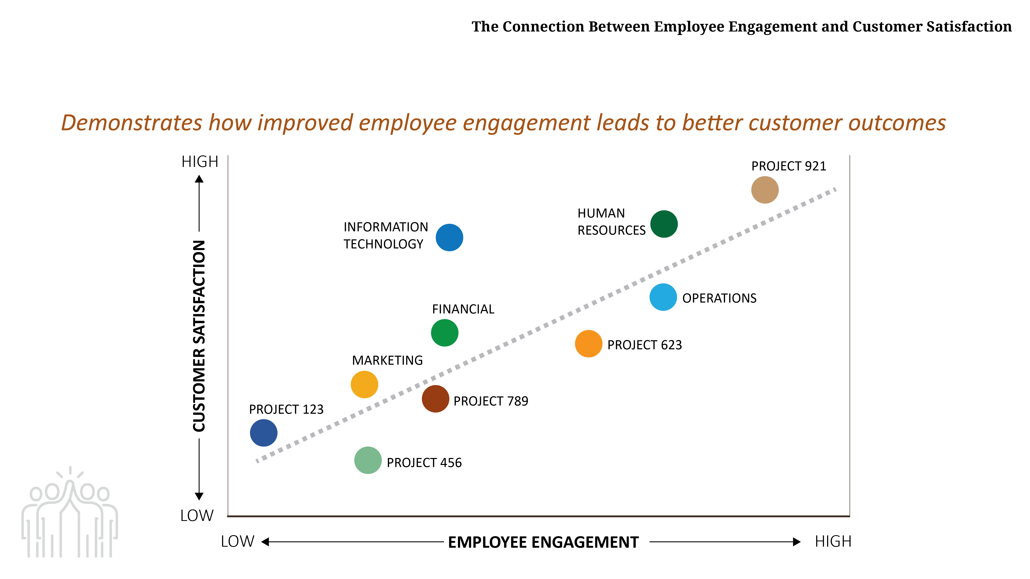
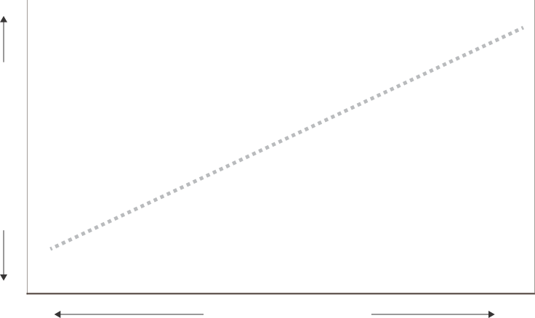

The Connection Between Employee Engagement and Customer Satisfaction
Demonstrates how improved employee engagement leads to better customer outcomes
HIGH
PROJECT 921
HUMAN RESOURCES
INFORMATION TECHNOLOGY
FINANCIAL
OPERATIONS
CUSTOMER SATISFACTION
PROJECT 623
MARKETING
PROJECT 123
PROJECT 789
PROJECT 456
LOW
LOW
EMPLOYEE ENGAGEMENT
HIGH

Slide 4


Cost Savings from Improved Retention Rates
Visualizes financial savings from reduced turnover
Implement professional development program
Introduction of community engagement program
Launch team building program
TURNOVER COST ($)
RECRUITMENT COSTS
ONBOARDING COSTS
LOST PRODUCTIVITY
Q1
Q2
Q3
Q4

Slide 5
Team Productivity Trends Over Time
Links cultural initiatives to increased team performance
Host an employee retreat
Introduction of cross-collaboration team building
Launch clarification of roles and responsibilities
MARKETING
OPERATIONS
HUMAN
RESOURCES
FINANCIAL
INFORMATION TECHNOLOGY
LOW
PRODUCTIVITY LEVELS
HIGH

Slide 6
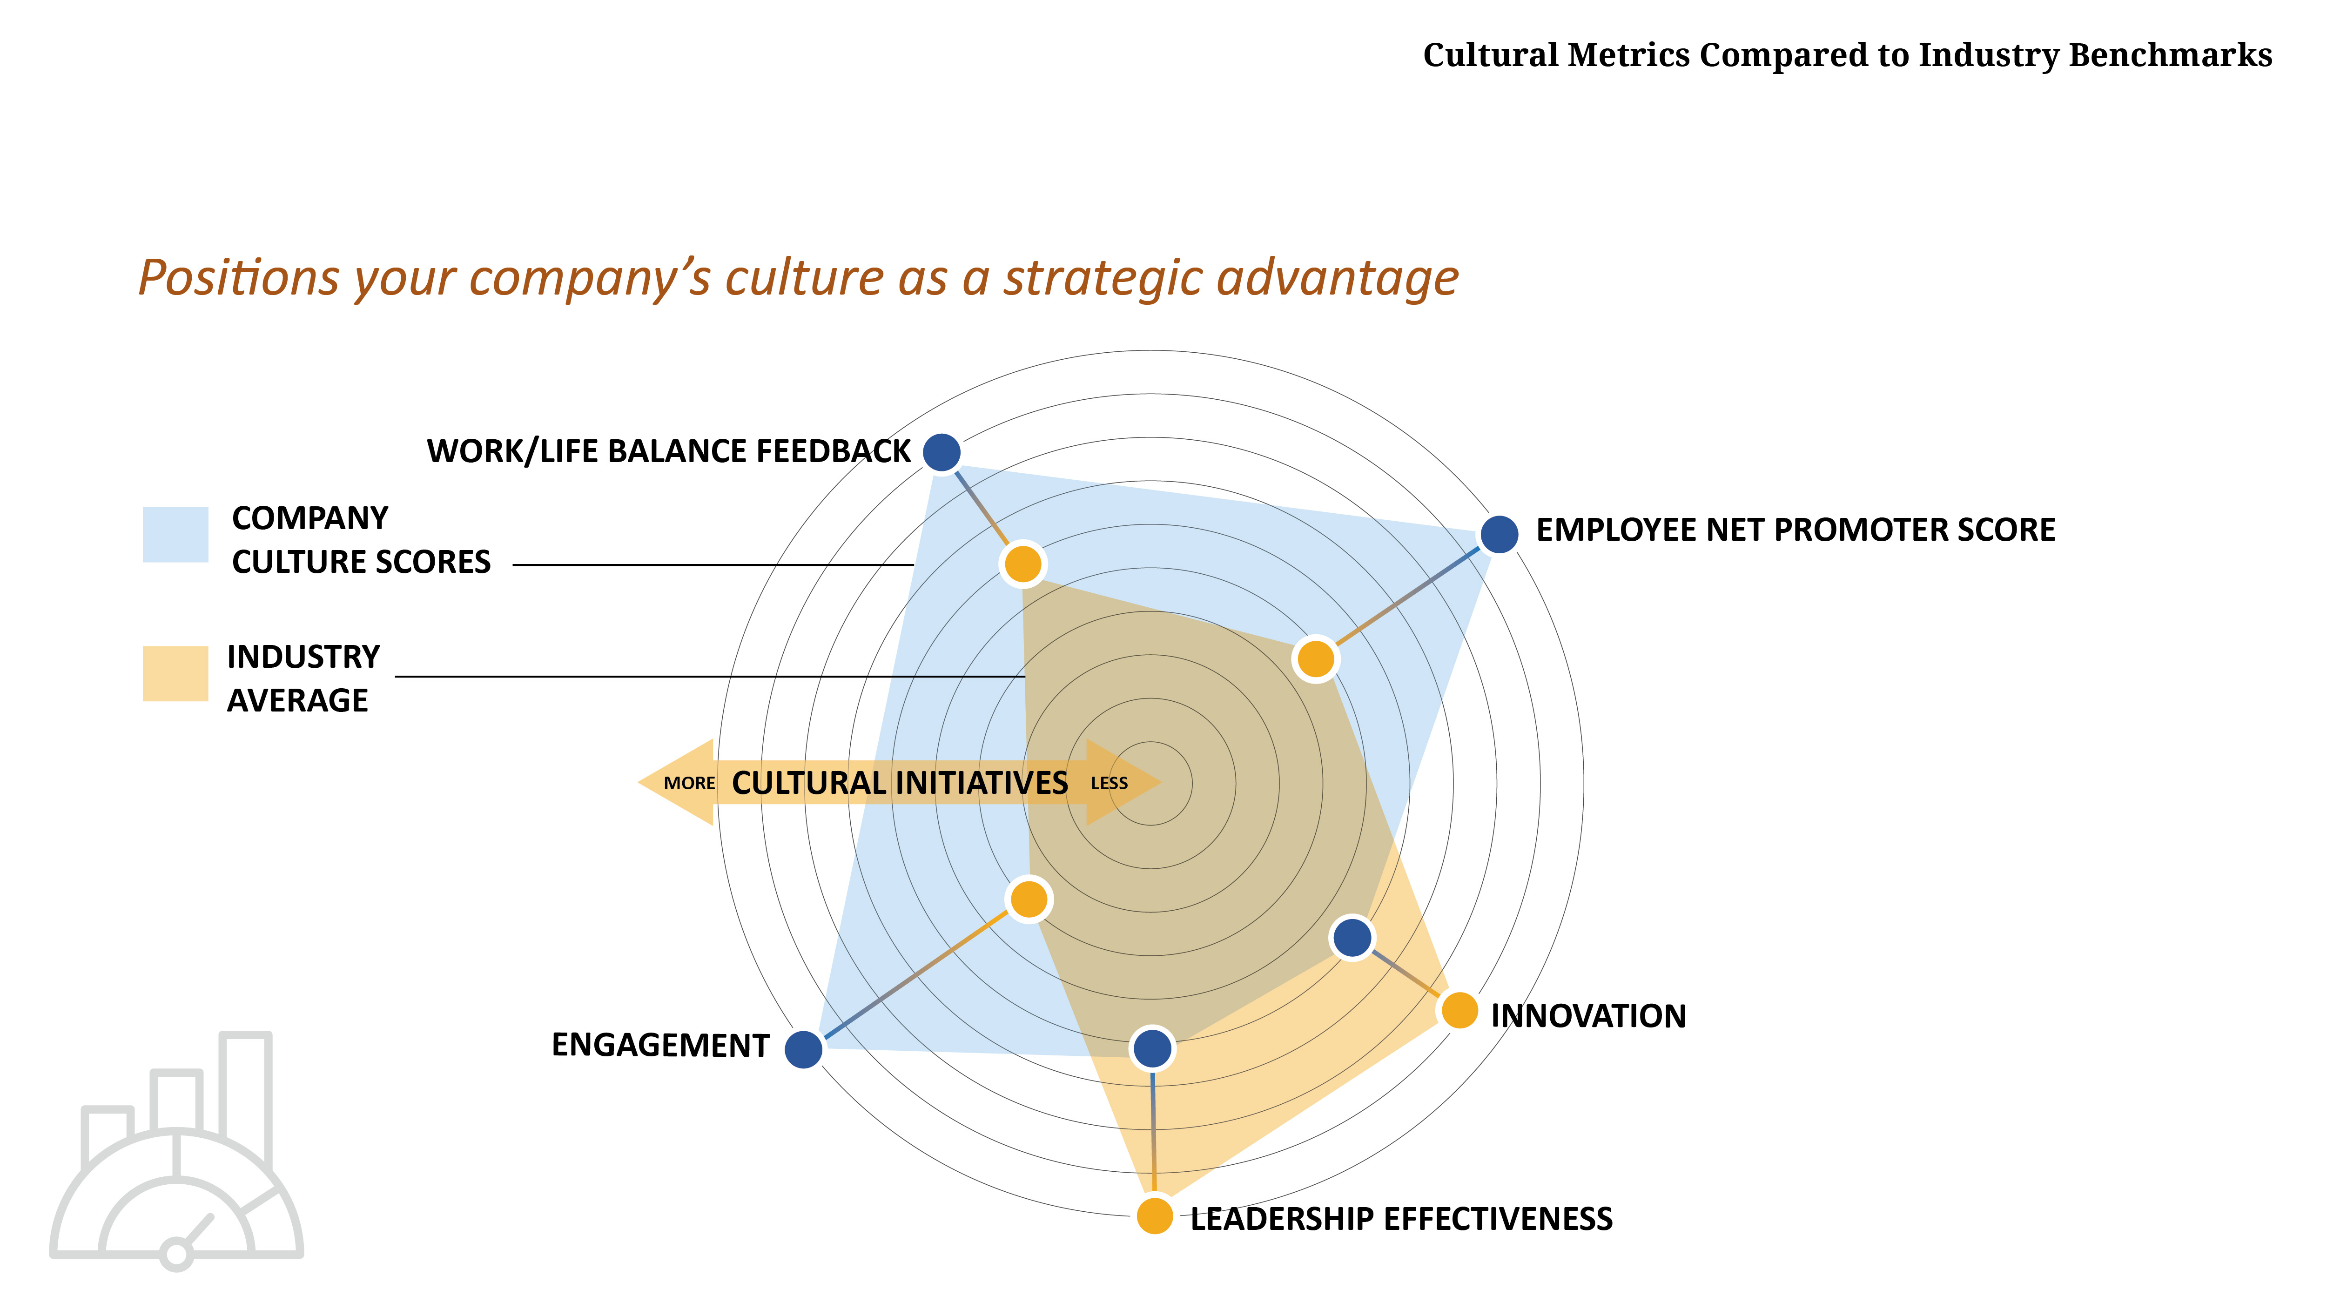
Cultural Metrics Compared to Industry Benchmarks
Positions your company’s culture as a strategic advantage
WORK/LIFE BALANCE FEEDBACK
COMPANY CULTURE SCORES
EMPLOYEE NET PROMOTER SCORE
INDUSTRY AVERAGE
MORE
CULTURAL INITIATIVES
LESS
INNOVATION
ENGAGEMENT
LEADERSHIP EFFECTIVENESS

Slide 7
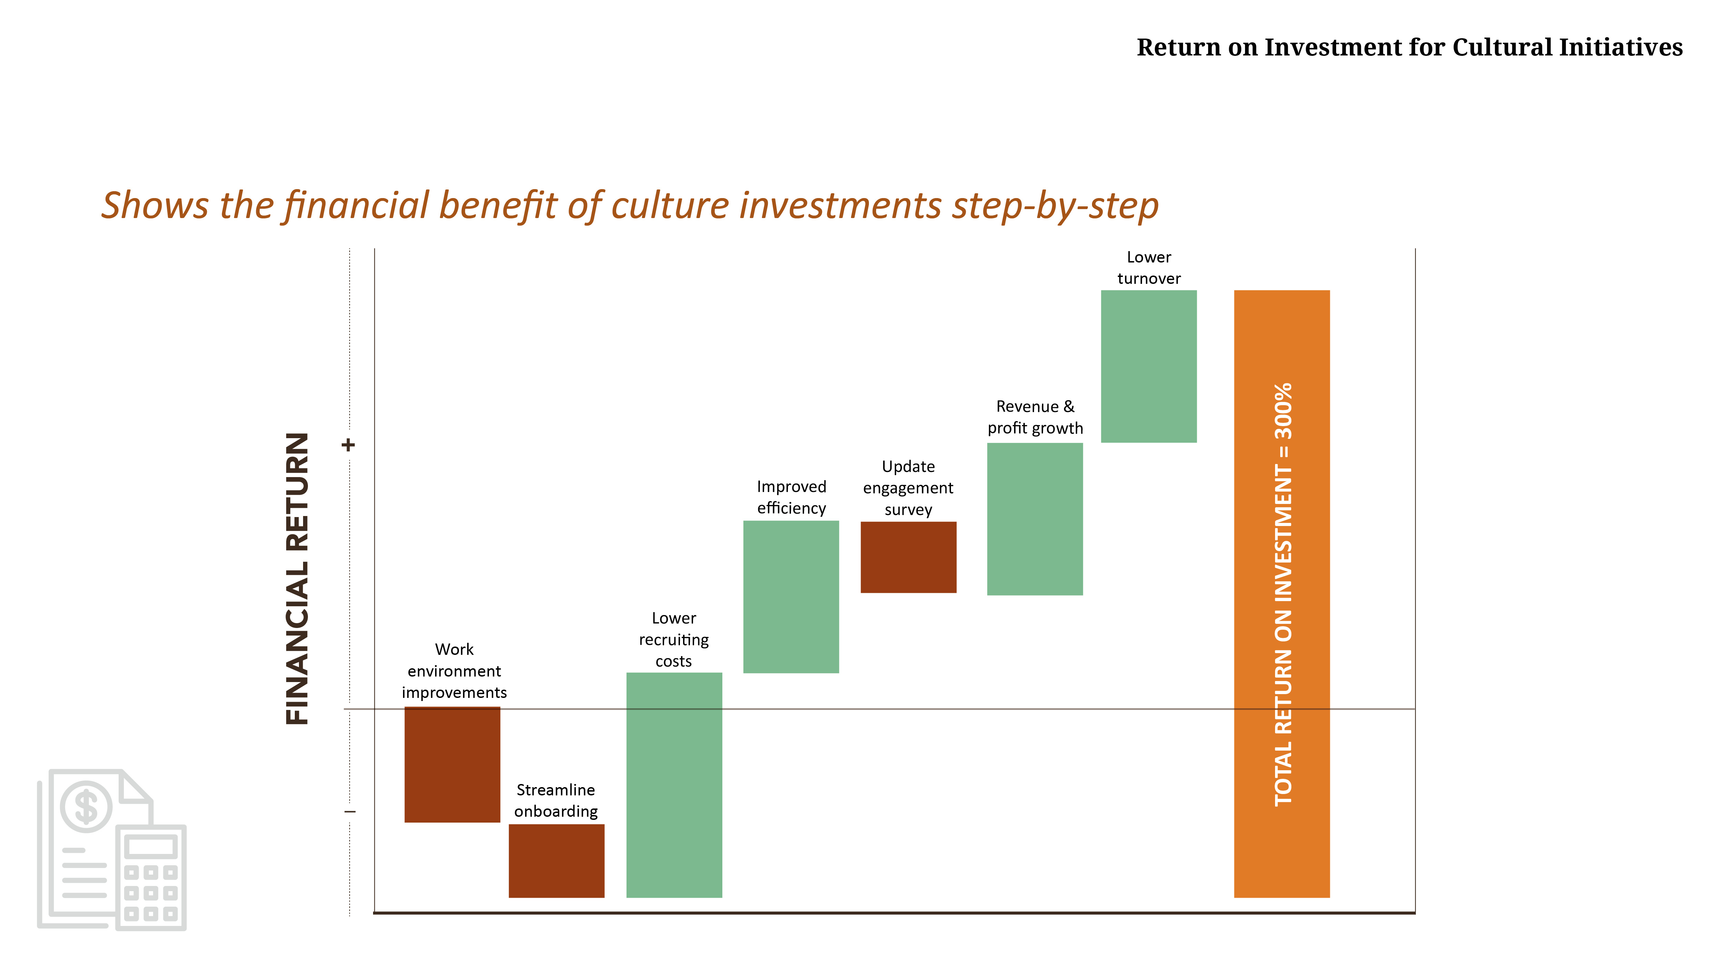


Return on Investment for Cultural Initiatives
Shows the financial benefit of culture investments step-by-step
Lower
turnover
Revenue & profit growth
+
Update engagement survey
Improved efficiency
FINANCIAL RETURN
TOTAL RETURN INVESTMENT = 300%
TOTAL RETURN ON INVESTMENT = 300%
Lower recruiting costs
Work environment improvements
Streamline onboarding
–

